Slide 1
Admissions and Grade Distributions
Kavya Desai, Adelaide Gray,
Nitin Kunaparaju, Michelle Ly,
Shivani Ravindra, Matthew Richardson,
Dongyon Ryu, Katherine Shen, Lillian Wu

Slide 2
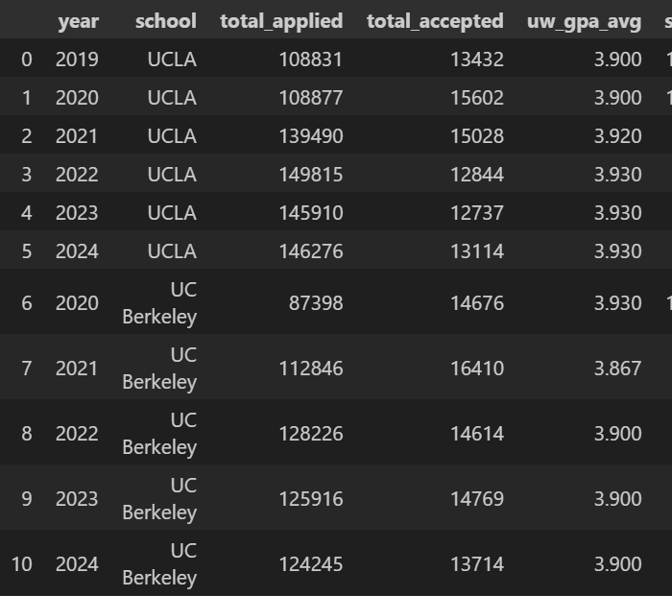
About the Data
2020-2024 CDS Dataset: UC Berkeley
2021-2024 CDS Dataset: UCLA
2019-2024 CDS: Harvard (not included)
Total applied students, total accepted, average unweighted GPA, bins for GPA range
2020-2024 UC Berkeley Grade Distributions
2021-2024 UCLA Grade Distributions
Berkeley: letter grades and counts for each class
UCLA: Professor, letter grades, and counts for each class
Notes:
Lillian
For our project, we decided to explore admissions data for UCLA and UC Berkeley and looked at any patterns in the grade distributions that each of the schools might have. We collected each year of data and organized them into csv files. Unfortunately, the publicly available common dataset for each school only went back to those years, and the publicly available grade distributions for UCLA only started in fall of 2021. For the common dataset, the columns that we primarily focused on were total number of students that applied, total number of students that were accepted, their average unweighted GPA, and the bins for each GPA range. For the grade distributions, we primarily focused on letter grade, which we mapped to GPA, as well as the number of people who got each respective letter grade. For UCLA, we also had data on which professor taught which class. For Berkeley Stats classes, we used stats classes that had the most data, and for UCLA, we focused on Stats 10, Stats 20, and the 100, 101, and 102 series.

Slide 3
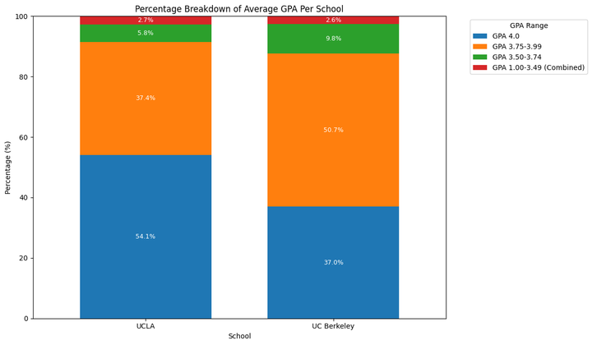
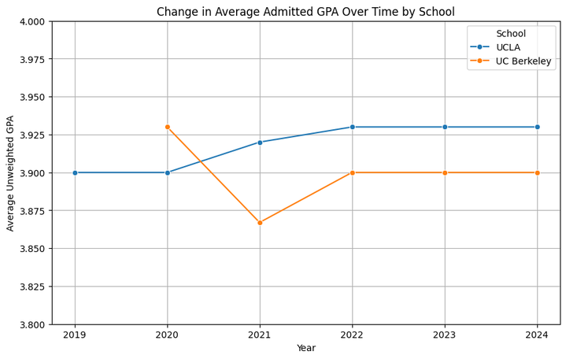
UCLA and UC Berkeley Admissions
UCLA focuses on GPA more than UC Berkeley
UCB has a slightly more proportionate distribution
No data for UCB in 2019
Only UCB experienced a decrease in 2021
Both schools consistent from 2022-2024
Notes:
Michelle
Percentage breakdown of average gpa per school:
-i did this by combining the average of gpas from 2019-2024
-since the 3 categories making up 1.00-3.49 made up a small percentage of the overall data, i combined them into one category- (red) both schools are about the same
-ucla places stronger emphasis on gpa than ucb, observing that almost 50% of their admitted students had a high school unweighted gpa of 4.0
-ucb is more proportionate and the 3.75-3.99 gpa category takes up the most percentage of the data
(transition to next graph)
-pretty consistent for ucla from 2019 to 2020 (3.9)
-no 2019 data for berkeley, around covid the admitted gpa dipped for berkeley (~3.925 to ~3.875) but not ucla (consistent with ucla weighing gpa more) as it increased till 2022
- in 2022 till 2024, both schools have been consistent with the average admitted gpa (ucla ~3.925, ucb ~3.9)
- because of our limited data, we could only observe these years. Therefore, the conclusions drawn is not entirely accurate and would require more data and statistical analysis.

Slide 4
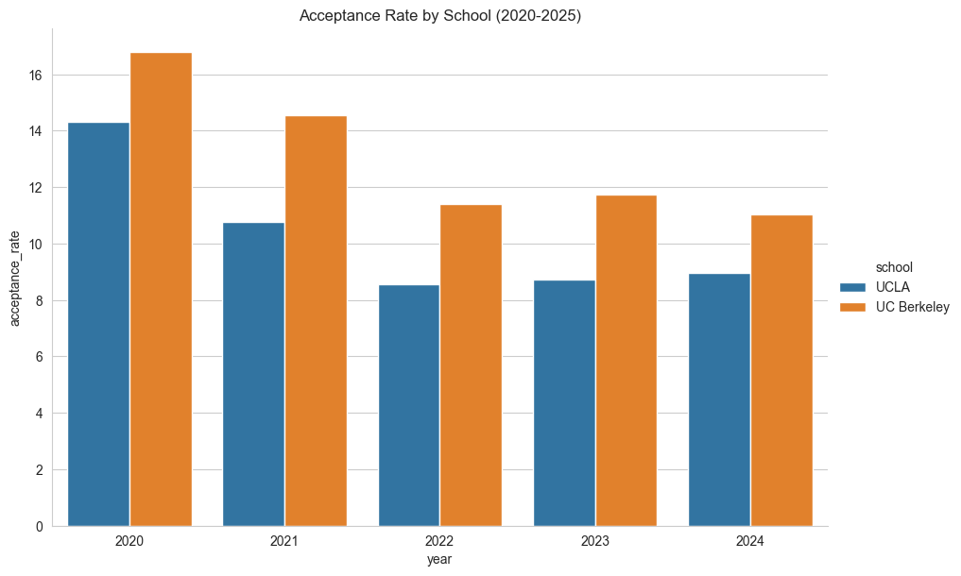
UCLA and UC Berkeley Admissions
Didn’t include Harvard
Acceptance rate decreasing over time
Impact of COVID?
Notes:
Nitin
Originally, we had data on harvard to observe if there were any differences between private and public universities. However, we chose not to include data from Harvard because we felt that there was little basis of comparison for harvard between ucla and uc berkeley, and it would be better to compare just UC Berkeley and UCLA seeing as they are much more similar to each other than Harvard.
We can see that after 2020, the acceptance rates for both UCLA and UC Berkeley continuously dropped until they leveled out at around 8.7% and 11.5 percent respectively. This is a significant drop from their acceptance rates from 2020, where UCLa had around a 14% acceptance rate, and UC Berkeley had over a 16% acceptance rate.

Slide 5
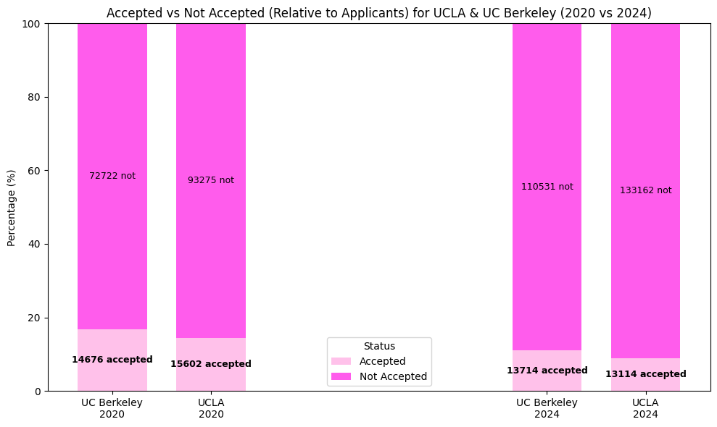
UCLA and UC Berkeley Admissions
Applications increased
Acceptances + Acceptance rates decreased
Notes:
Nitin
We can see that although acceptance rate has gone down, the number of applicants has increased. In theory, this would make sense if the schools continued to accept roughly the same number of students, but both of the schools have actually been admitting less students than in the past. It may be the case that during 2020, as schools shifted to online instruction, they accepted an increased number of students as they didn’t need to house them on-campus. But as instructions returned to in-person, there may have been an overcrowding of students, which led to less students being accepted. It could also be possible that changes to the application process, such as removing SAT/ACT requirements could have had an impact on the number of acceptances.

Slide 6
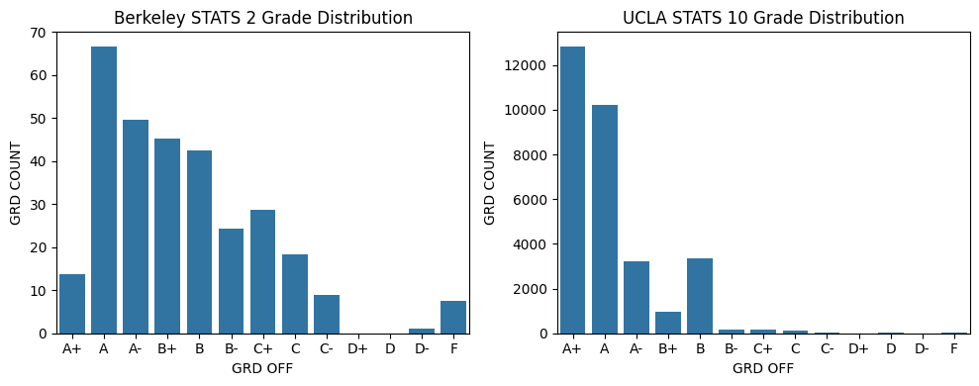
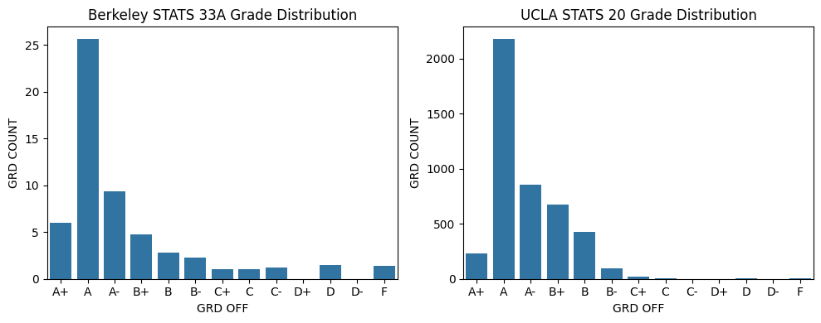
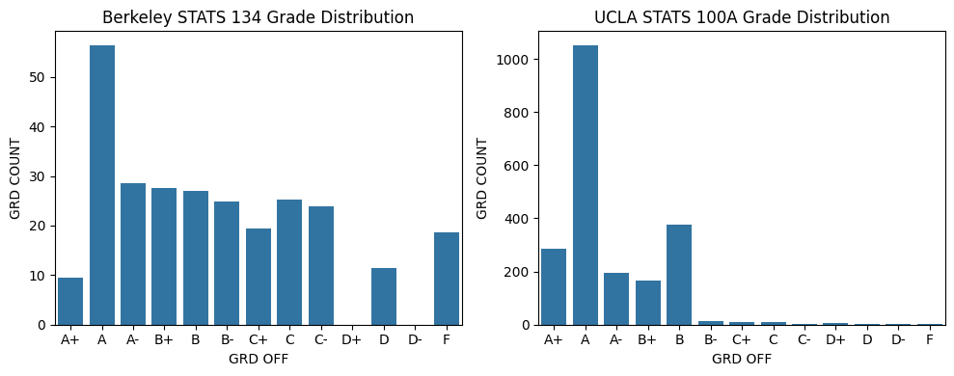
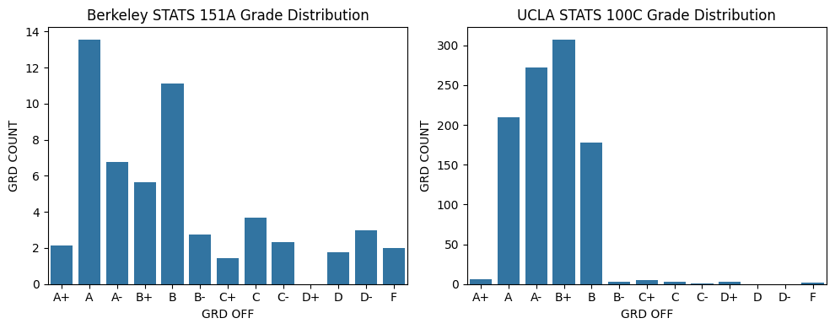
UCLA and Berkeley Grade Distributions
Notes:
Shivani
In order to compare the grade distributions for UCLA’s stats classes with Berkeley’s I combined the data for all years and professors together by just filtering out the data based on the subject area and catalog number for the class that I was trying to visualize. For almost all of the classes, Berkeley’s distributions have a lot more variance in grades in comparison to UCLA. All the graphs, for Berkeley and UCLA are right skewed. UCLA also has a lot more data because their grade counts go up to the thousands while Berkeley’s maximum grade count is 70. The distributions for stats 33a and stats 20 are very similar but most of the other distributions look very different since the grades from Berkeley’s classes are much more spread out than UCLA’s. UCLA’s grade averages tend to be in the A/B range as there’s very few students who got below a B- in the UCLA classes while the grade averages for the adjacent classes at Berkeley are lower with more students receiving lower grades.

Slide 7
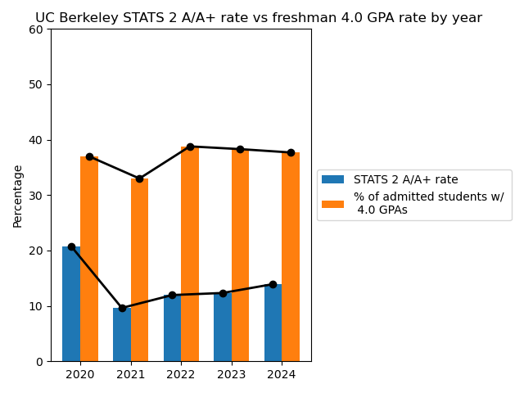
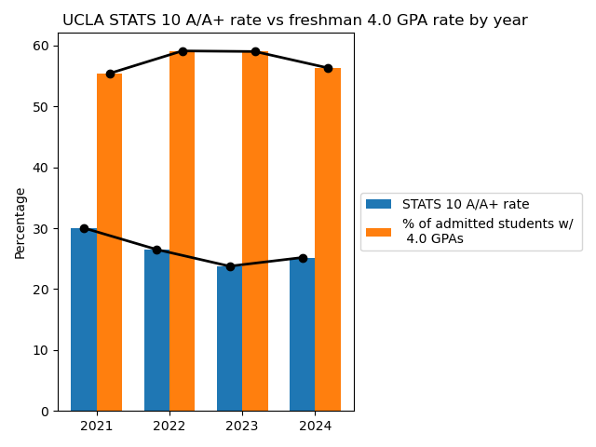
Stats 10/Stat 2 and GPA
Stats 2 and Stats 10 are generally considered freshman courses at UC Berkeley and UCLA, respectively
A/A+ rates by year are calculated by totalling number of A/A+s in all Stats 2/10 courses from every term of the school year, then dividing by total number of students taking the course
  School year = year that the school year begins with (ex: 2021-2022 academic year is counted as 2021)
Notes:
Katherine
We took a closer look at two stats classes in particular, Stats 10 at UCLA and Stats 2 at Berkeley. Since we had datasets on the grade distributions for all stats classes at these two schools and on freshman acceptance data, we decided to examine these two specific classes because they’re typically taken by freshman at their respective schools. These two graphs are visualizations of the percentage of admitted students who had 4.0 unweighted GPAs each year compared to the percentage of students in the freshman statistics courses who had As and A+s, which is equivalent to a 4.0 in the course.

Slide 8
Stats 10/Stat 2 and GPA
Observations:
  UCLA’s STATS 10 A/A+ rate actually decreases as the 4.0 rate for freshmen increases
  Berkeley’s STATS 2 A/A+ rate seems to generally follow the trend of the freshman 4.0 rate
Although the observed patterns are useful, further statistical testing is needed to make conclusions about correlation
Notes:
Katherine
Based on the graphs, we observed some interesting patterns. The UCLA freshman stats course’s 4.0 rate actually decreased as the 4.0 rate for freshmen increased, while the UC Berkeley’s course’s 4.0 rate seemed to follow the freshman 4.0 rate’s trend. Between the two schools, UC Berkeley’s admitted students had a lower percentage of perfect GPAs than UCLA and their freshman stats class’s 4.0 rate was also lower than UCLA’s corresponding course. However, although these observations are insightful, we would have to conduct further statistical testing to draw conclusions about any possible correlation. There is also some uncertainty regarding the exact makeup of the freshman stats classes, differences in how professors teach, and more, so we would also examine those factors more closely if we wanted to draw more specific conclusions.

Slide 9
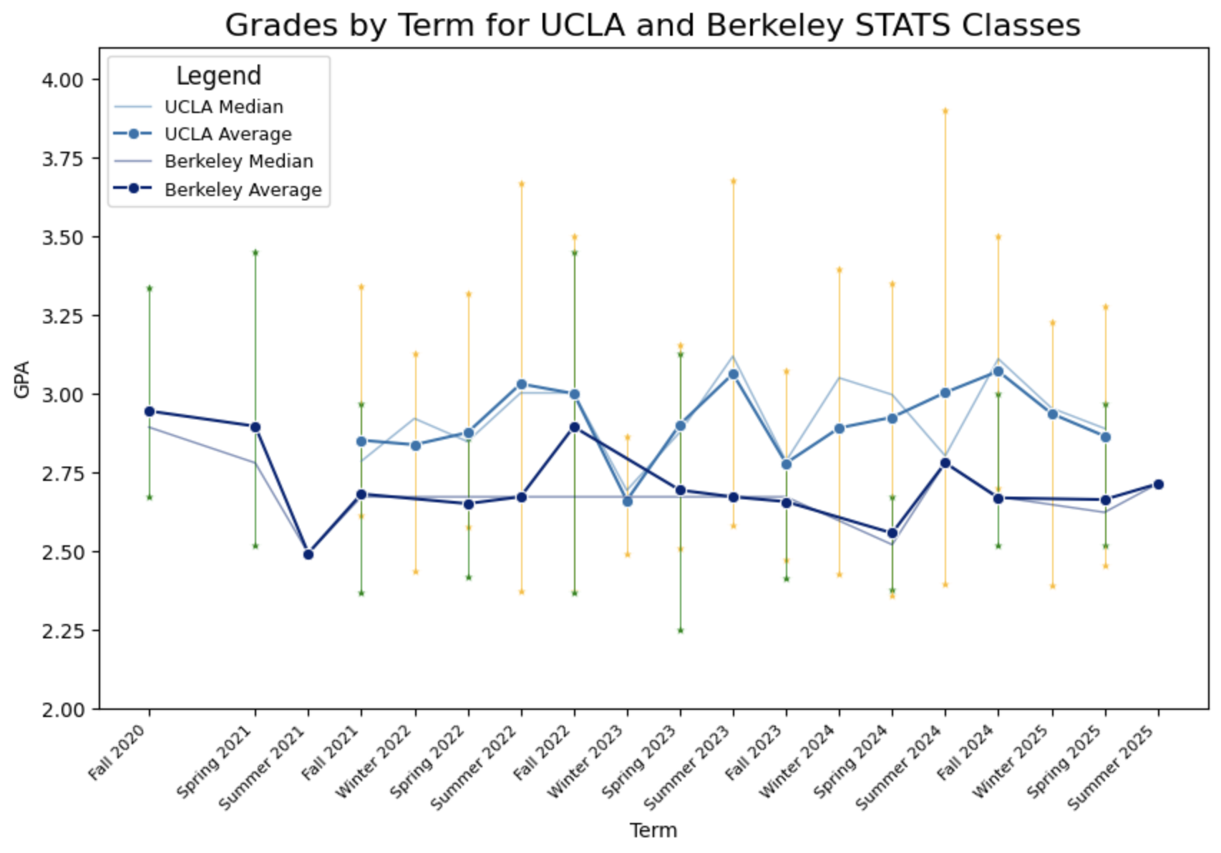
Stats Grade Averages by Quarter/Semester
Average grade across all the stats classes each term
  Darker blue lines
Median grade across all the stats classes each term
  Lighter blue lines
Max and min average grade of a stats classes in the school
  Yellow vertical lines: UCLA
  Green vertical lines: Berkeley
Notes:
Adelaide
This graph shows data for the class averages for each stats class in each term.
I did this by finding the average grade for each stats class, then graphing the mean, median, maximum, and minimum class average for each term.
The darker blue lines show the average grade across all the stats classes
The lighter blue lines show the class that had the median class average among all the stats classes
The vertical lines show the range between the minimum and maximum class average for each term.
We can see that UCLA usually has slightly higher average grades than Berkeley does.
The Berkeley dataset only had one Stats class for each summer term. This is why the mean, median, minimum, and maximum are all at the same point every summer term.

Slide 10
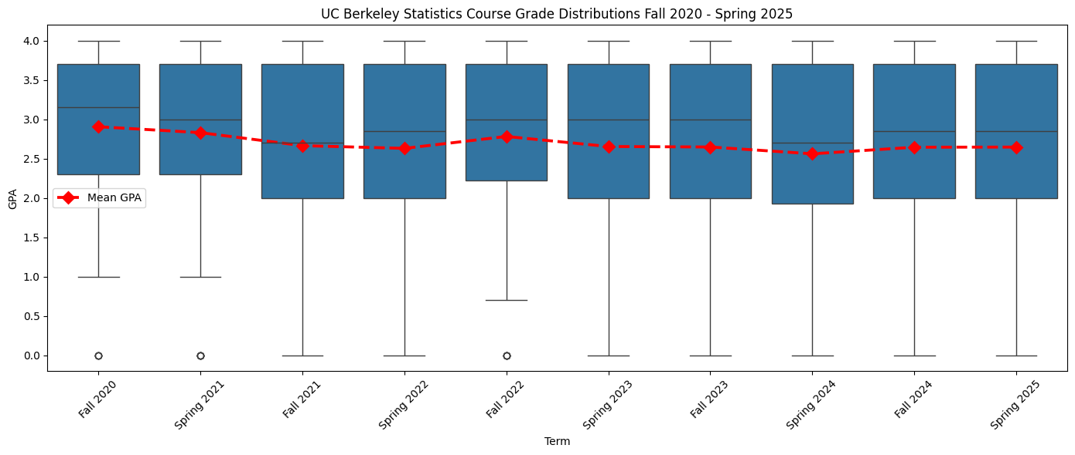
UC Berkeley Stats Course Grade Distributions
Shows the overall distribution (box plots) and mean GPA (red points) of UCB Stats courses from Fall 2020 to Spring 2025
Overall pretty stable mean. But distributions seem to vary across years, so we investigated this variance (next slide)
Notes:
Kavya
This graph shows how grade distributions changed from Fall 2020 to Spring 2025; the x-axis shows every semester in this range in order so we can observe any trends in the distribution. Summer semesters were not included because they are not considered regular semesters and their unique circumstances might affect grade distributions disproportionately.
The y-axis shows the grade distribution, and to get these values we mapped the letter grades to their respective GPA on the 4-point GPA scale that the UC schools use.
Overall, the mean grade in UCB stats courses has remained fairly constant, but the distributions seem to be varying. To investigate how exactly the distributions were changing, we observed the standard deviations and skew of each semester’s grades (next slide).

Slide 11
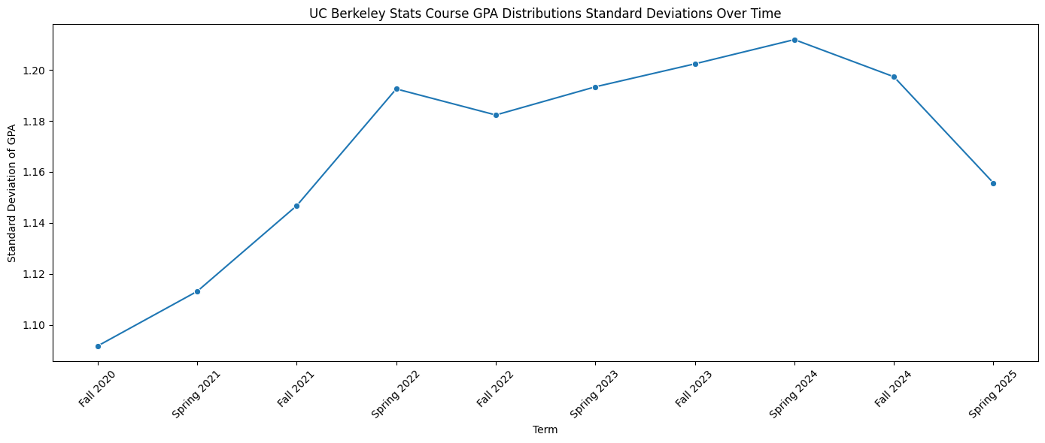
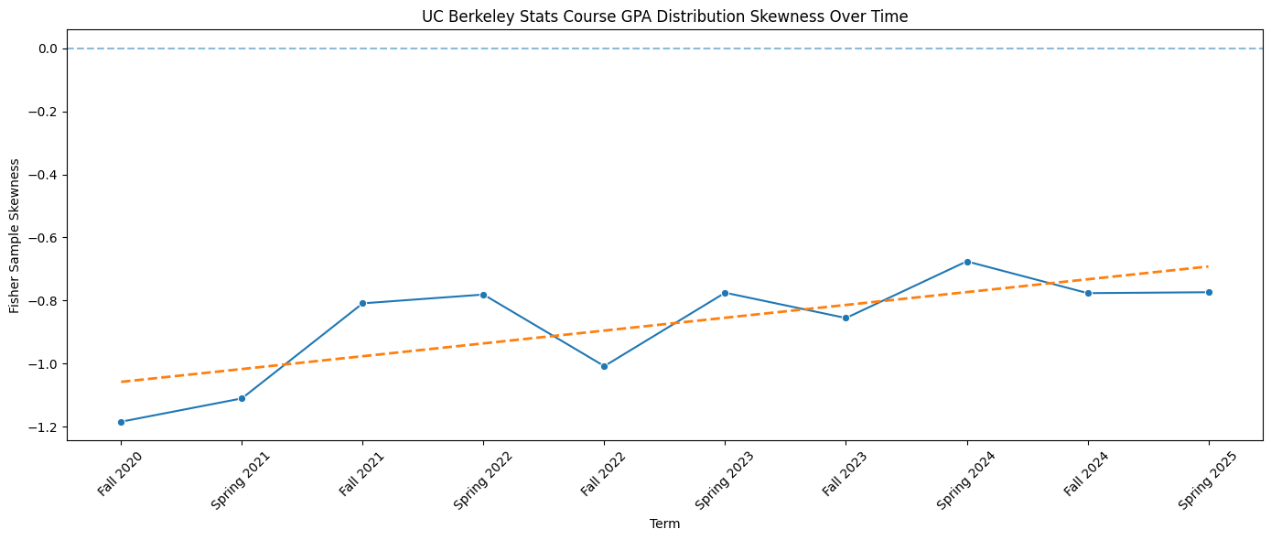
UC Berkeley Stats Course Grade Distributions
Standard Deviations
Skew
Standard Deviations of grade distributions were increasing until Spring 2024
Could indicate that there was a widening performance gap between students in UCB Stats Courses
Skew of grade distributions is increasing
Could be an indicator of grade inflation; skew becoming closer to zero means the left tail is shrinking, so less students are receiving low grades
Notes:
Kavya
These graphs show the observations from plotting the standard deviations and skew of each semester’s grade distributions. Standard deviation was calculated using the sample standard deviation formula and skew was calculated using the Fisher-Pearson Sample Skewness formula (basically, a negative value means long left tail and more clustering near higher values and vice versa; makes sense that all values are negative because most people get A/B grades than D/F grades).
The standard deviation graph shows that the standard deviation increased until spring 2024, which could mean there is a widening performance gap between stats students at UCB.
The skew graph shows an increasing trend, which could be an indicator of grade inflation; skew becoming closer to zero means the left tail is shrinking, so less students are receiving low grades

Slide 12
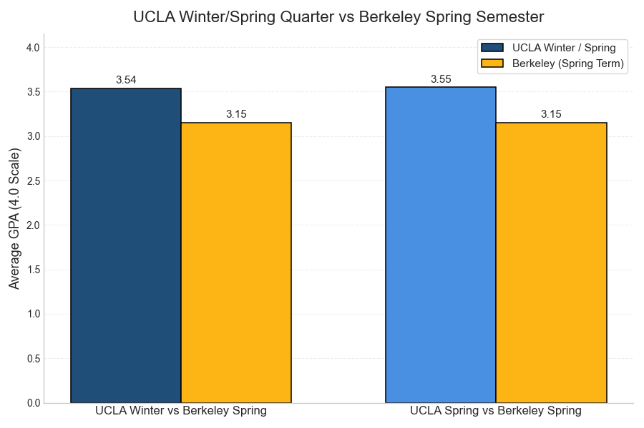
GPA Comparison: UCLA Winter/Spring vs Berkeley Spring
We compared UCLA’s winter and spring quarter GPAs to Berkeley’s spring semester to see if the extra UCLA term affected grades.
UCLA’s averages (3.54 and 3.55) were higher than Berkeley’s spring GPA (3.15).
The extra quarter at UCLA did not seem to lower GPA performance.
Notes:
Matthew
We compared UCLA’s winter and spring quarter GPAs to Berkeley’s spring semester to see if the extra UCLA term affected grades.
UCLA’s averages for winter quarter and spring quarter (3.54 and 3.55 respectively) were higher than Berkeley’s spring GPA (3.15).
Seeing as there is little change in UCLA winter and spring, the extra quarter at UCLA did not seem to lower GPA performance.

Slide 13
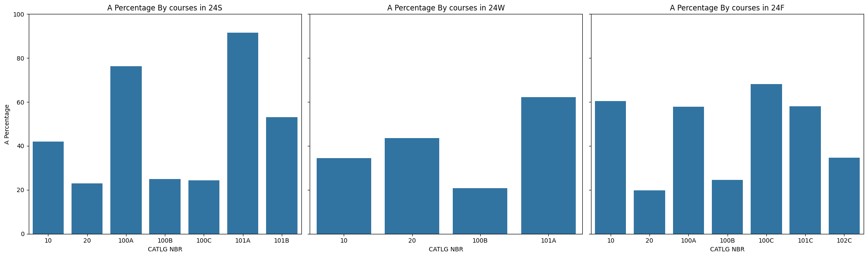
A+/A rate Trends by Course and Instructor
A Percentages change noticeably from quarter to quarter
Some courses show big jumps or drops from quarter to quarter
Overall: A rates are not consistent and depend heavily on the quarter.
Notes:
Dongyon
We analyzed grade distributions in UCLA stats classes across three quarters. We first looked at A rates by course to see how grades change from term to term. Then, We analyzed A rates by instructor. On this slide, we can see that A rates shift quite a lot from one quarter to the next. Some courses have big increases or decreases depending on the term. Overall, the data suggests that the quarter you take the class in has a major impact on how likely students are gonna receive an A

Slide 14
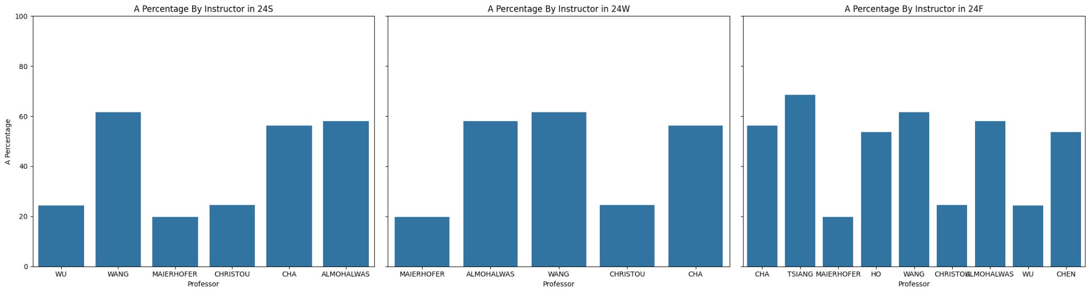
A+/A rate Trends by Course and Instructor
A Percentage vary a lot between instructors
Some professors consistently give higher A rates.
Others tend to grade more strictly
Overall: instructor grading style has a major impact on A percentage.
Notes:
Dongyon
In this slide, we can see that A rate vary quite a lot depending on the instructor. Some professors, like Wang and cha consistently show higher A rates across multiple quarters. Others, such as Wu, and Christou, tend to grade more strictly. This tells us that instructor grading style plays a major role in the overall grade distribution.

Slide 15
Next Steps with More Data/Time
Raw grades for professors to observe curves
Explore admissions over a longer period of time
  Specifically examine UC admissions before and after the UC system went test blind
  Explore trends from before and after COVID-19
Explore trends from specific schools and majors within UCLA and UCB
Use Tableau to create interactive graphs
Notes:
If we had the data to some professors’ raw grades, especially for the upper div classes, then we could observe how curves change throughout the years or how different professors curve different grades.
We were also initially interested in how going test blind may have affected UC admissions trends but we were unable to get data from when UCs looked at standardized tests during admissions. If we had this data, we would study any potential differences in the GPAs, class ranks, etc. of admitted students before and after the test blind policy went into effect. Additionally, exploring how admissions trends and grade changes could have been affected from COVID-19 could have been useful to see if there were any grade changes specifically before 2020 and after 2020. However, since UCLA only had data starting from 2021, we were unable to explore this. Furthermore, looking beyond the Stats department and looking more at introduction courses for different majors, such as life science, economics, and computer science, could have shown how some trends differ depending on the class itself rather than UCLA as a whole. Finally, if we had more time, we could have used Tableau to create interactive graphs, such as changing the graphs based on the quarter or year and showing a side by side comparison for UCLA and UC Berkeley.

Slide 16
Thank you!

